Slide 1

My Presentation
Whitiora

Slide 2



Agenda
Introduction – (what is this all about)
Getting Started – (what research did you do)
Interview Description – (who was the user, what are their needs)
Selection – (explain a few considerations)
Justification – (why does this fit the users needs)

Slide 3
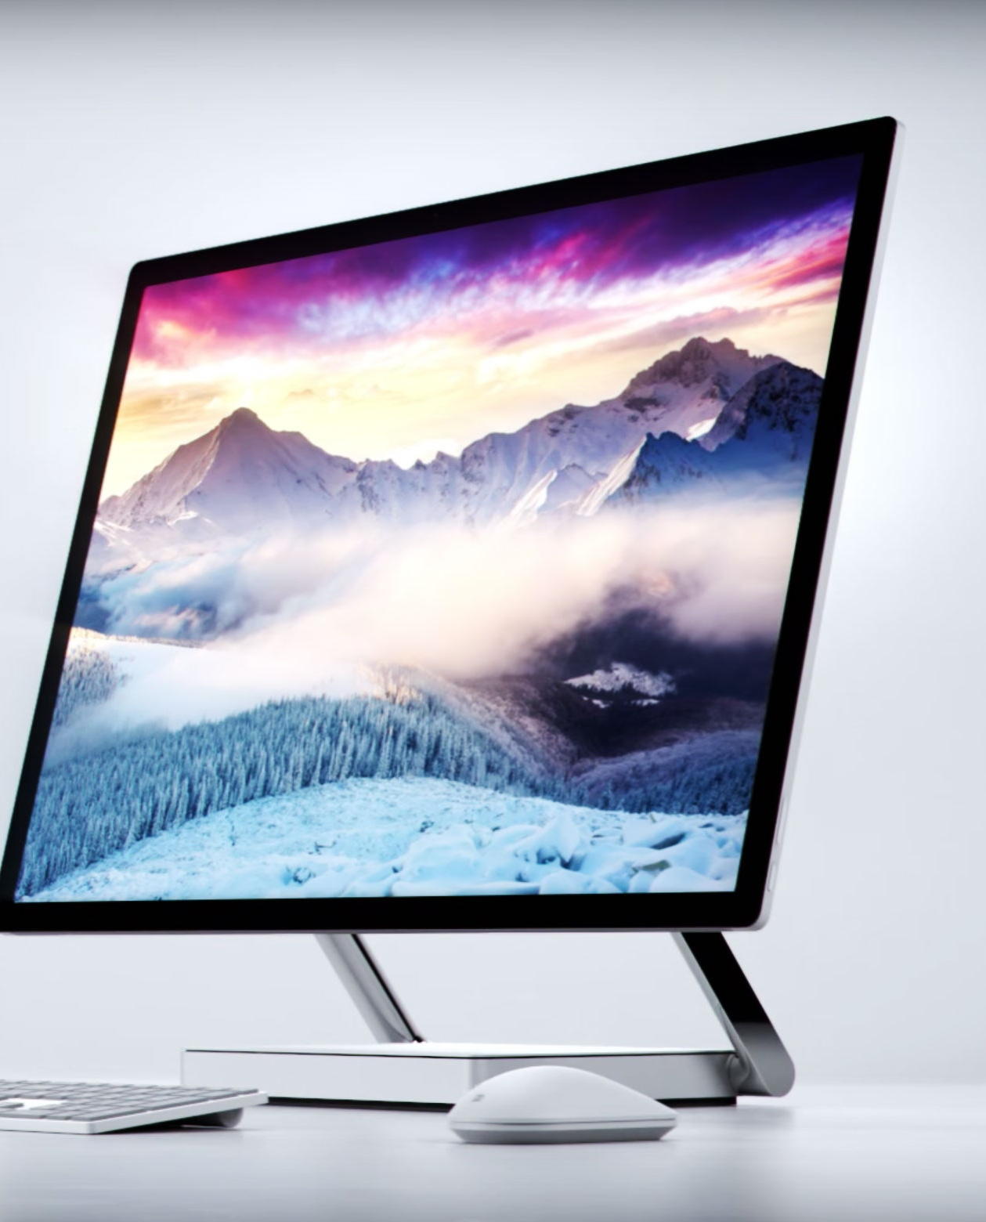
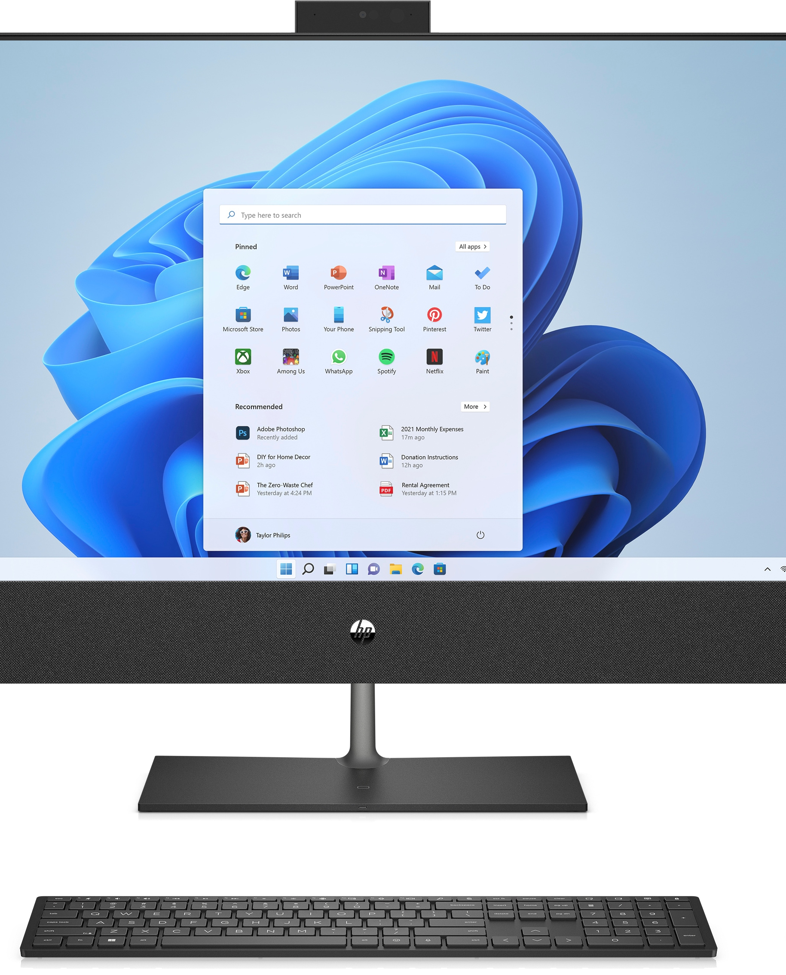
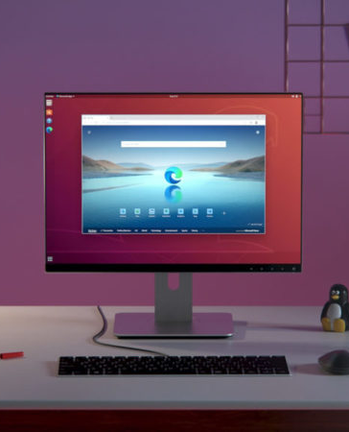
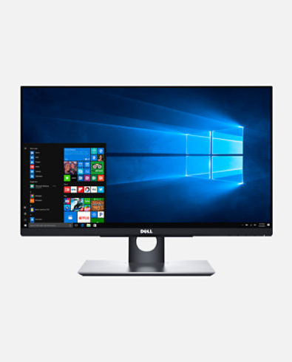
Introduction
Hi my name is Whitiora, and my PowerPoint is about computers. In class we have been learning about different parts of a computer and how they function. I also got to take apart an old PC and see all the parts inside of it, later my team and I had to try put it back together again.

Slide 4

Getting Started
The research that I done was to find out what each part of the computer was used for, for example a monitor is used for a display's information in pictorial or textual form.

Slide 5
Interview Description
The person I interviewed was my mum, my mum used a computer at her work. She used it to email her work mates and others. Her needs were that she needed another desktop computer cause her one was getting old, and it needed to be updated. That’s why I recommended for her to get the Dell OptiPlex 7400 computer.

Slide 6
Selection
Subtitle

Slide 7
Justification
The Dell OptiPlex 7400 computer was best for mum because it was easy to use, and it was newer than her old one.

Slide 8

Summary
In conclusion, I think that the person I interviewed should get the Dell OptiPlex 7400 computer, because it will make their job easier now and, in the future.

Slide 9


Thank You
Whitiora
Wbrady-brown@stu.kerikerihigh.ac.nz
Website address: I dont have one

Slide 10
Team
Whitiora 1
Whitiora 2
Whitiora 3
Whitiora 4
Team Leader
Interviewed the person
Researcher
Presentation

Slide 11
Chart

Slide 12
Table
 | Category 1 | Category 2 | Category 3 | Category 4
Item 1 | 4.5 | 2.3 | 1.7 | 5
Item 2 | 3.2 | 5.1 | 4.4 | 3
Item 3 | 2.1 | 1.7 | 2.5 | 2.8
Item 4 | 4.5 | 2.2 | 1.7 | 7

Slide 13

The way to get started is to quit talking and begin doing.
Walt Disney

Slide 14
Timeline
Title
To start a presentation, go to the Slide Show tab, and select From Beginning.
Title
To display Presenter view, in Slide Show view, on the control bar at the bottom left select the three dots, and then Show Presenter View.
Title
During your presentation, the speaker notes are visible on your monitor, but aren't visible to the audience.
Title
Title
If you don’t see the Notes pane or it is completely minimized, click Notes on the task bar across the bottom of the PowerPoint window.
The Notes pane is a box that appears below each slide. Tap it to add notes.

Slide 15
Content
Subtitle
Subtitle
Add text, images, art, and videos.
Add transitions, animations, and motion.
Save to OneDrive, to get to your presentations from your computer, tablet, or phone.
Open the Design Ideas pane for instant slide makeovers.
When we have design ideas, we’ll show them to you right there.

Slide 16
Content 2
Subtitle
subtitle
subtitle
Add text, images, art, and videos.
Add transitions, animations, and motion.
Save to OneDrive, to get to your presentations from your computer, tablet, or phone.
Open the Design Ideas pane for instant slide makeovers.
When we have design ideas, we’ll show them to you right there.
Add text, images, art, and videos.
Add transitions, animations, and motion.
Save to OneDrive, to get to your presentations from your computer, tablet, or phone.
Open the Design Ideas pane for instant slide makeovers.
When we have design ideas, we’ll show them to you right there.
Add text, images, art, and videos.
Add transitions, animations, and motion.
Save to OneDrive, to get to your presentations from your computer, tablet, or phone.
Open the Design Ideas pane for instant slide makeovers.
When we have design ideas, we’ll show them to you right there.

